Slide 1

Automating xlsx & docx FILES
A pop-up project

Slide 2
Reference material
“Python-docx-template” by elapouya
https://github.com/elapouya/python-docx-template/blob/master/tests/richtext.py
“Automating Microsoft Excel and Word Using Python” by M. Khorasani
https://towardsdatascience.com/automate-microsoft-excel-and-word-using-python-4244c613f818
Python-docx-template Documentation
https://docxtpl.readthedocs.io/en/latest/

Slide 3
Libraries
Openpyxl
Interacts with Excel files (.xlsx and xls.) to read, populate and manipulate values through the rows and columns
Python-docx-template, or docxtpl
Interacts with Word files (.docx) to manipulate document
DocxTemplate
Creates template for python to reference
RichText
Creates dynamic texts with changeable styles (i.e. colour, bold, italic, size)

Slide 4
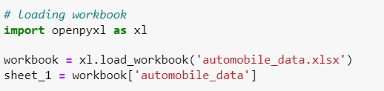
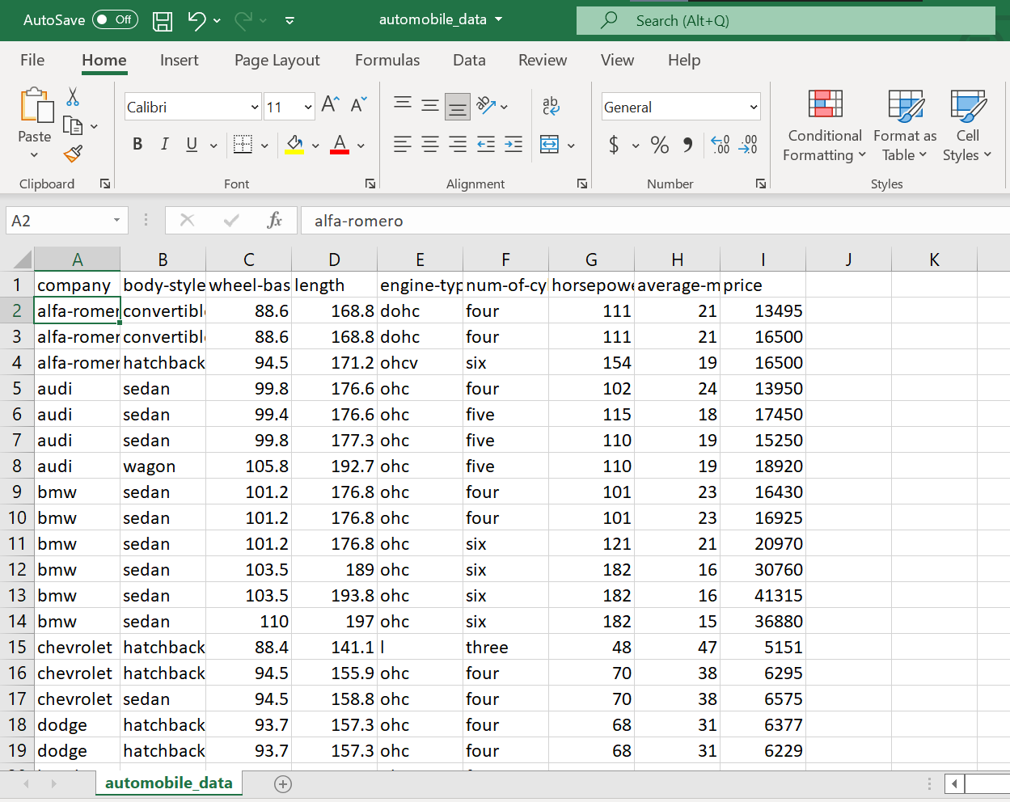
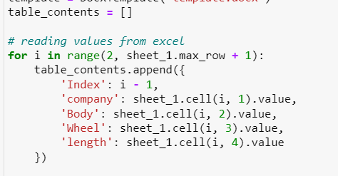
Openpyxl
Directs python to the desired Excel file with data to be transferred to the word documents.
Stores data in specified variables based on specified columns

Slide 5
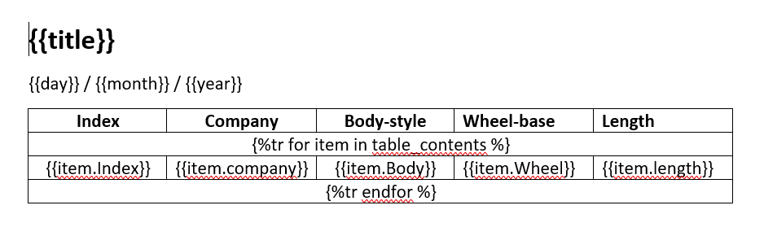
Loading Template
Reference desired template to populate Word document
Use of placeholders – variables encapsulated with “ {{ var }} ” to display stored data
Use of RichText to change font style

Slide 6
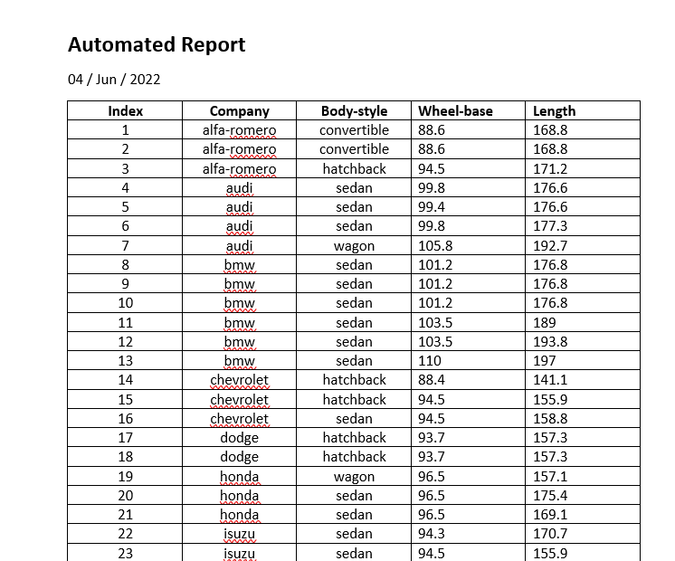
Aggregating Excel data into a table in Words

Slide 7
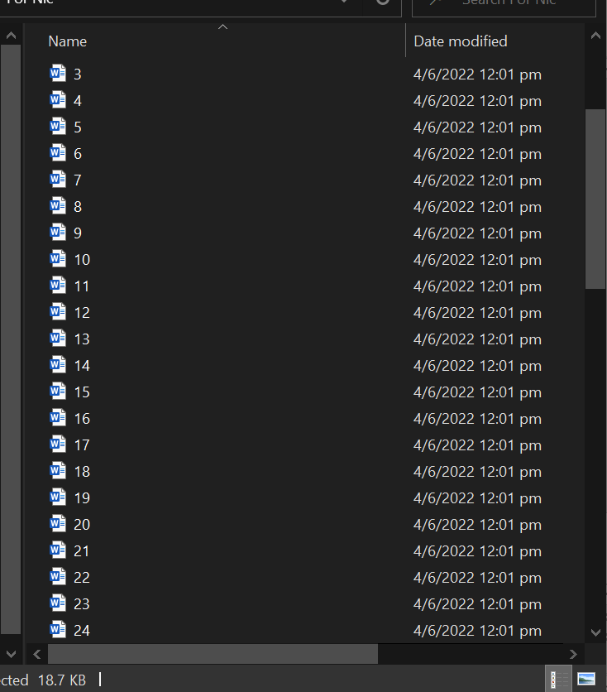
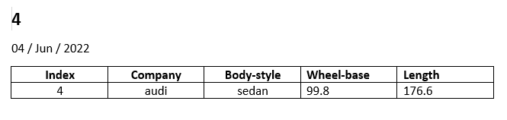
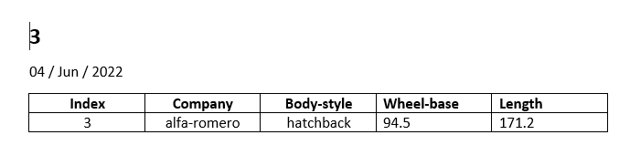
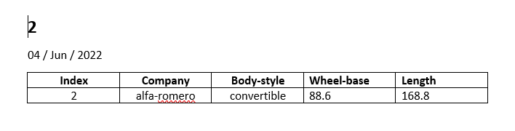
Aggregating Excel data into multiple documents

